Slide 1
Graphic novel terms
Information from Understanding Comics by Scott McCloud

Slide 2
Panels
Distinct segment of the comic, contains text and images

Slide 3
Transitions
Movement from panel to panel.
Requires closure ("phenomenon of observing the parts but perceiving the whole" (McCloud, pg. 63) or being able to fill in the gaps as we read.

Slide 4
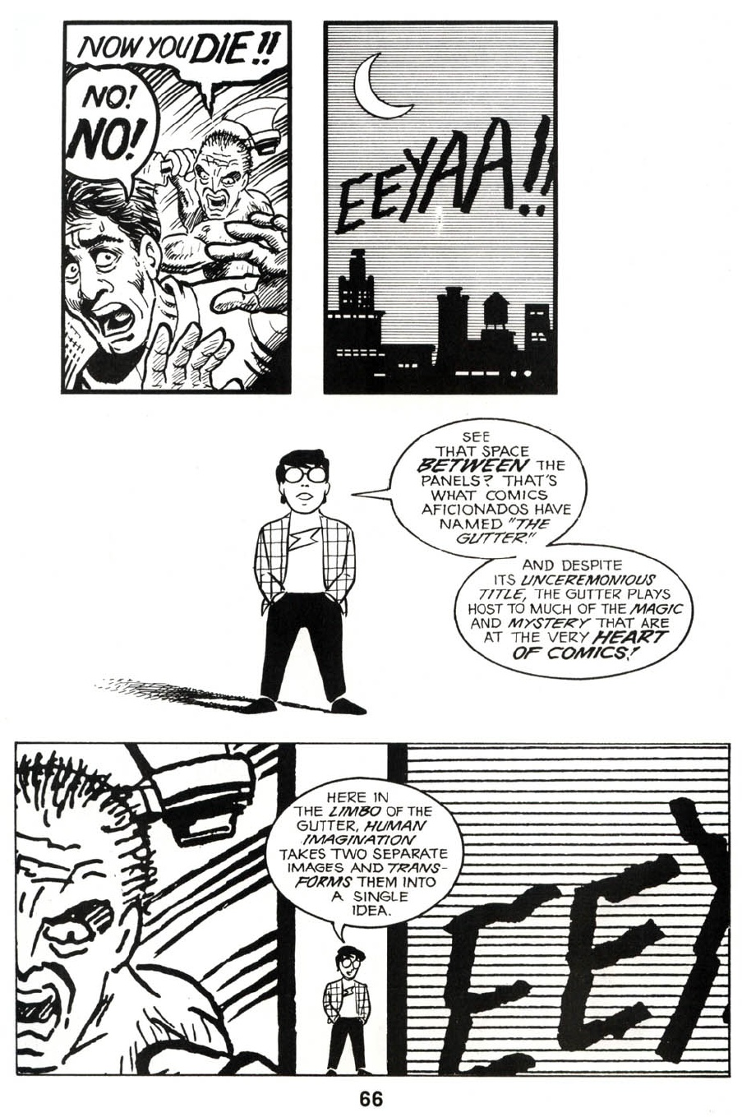
GUTTER
Space between framed panels

Slide 5
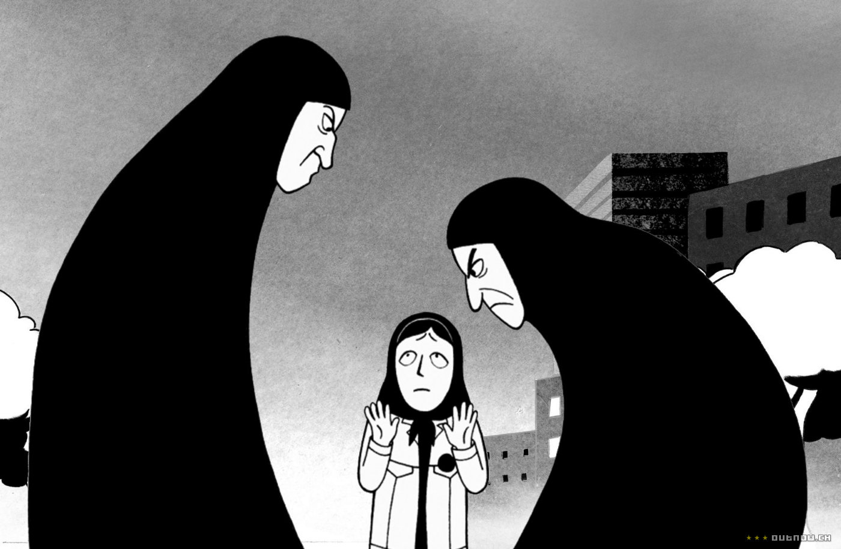
Graphic Weight
The way some images draw the eye more than others; creates focus using color and shading

Slide 6
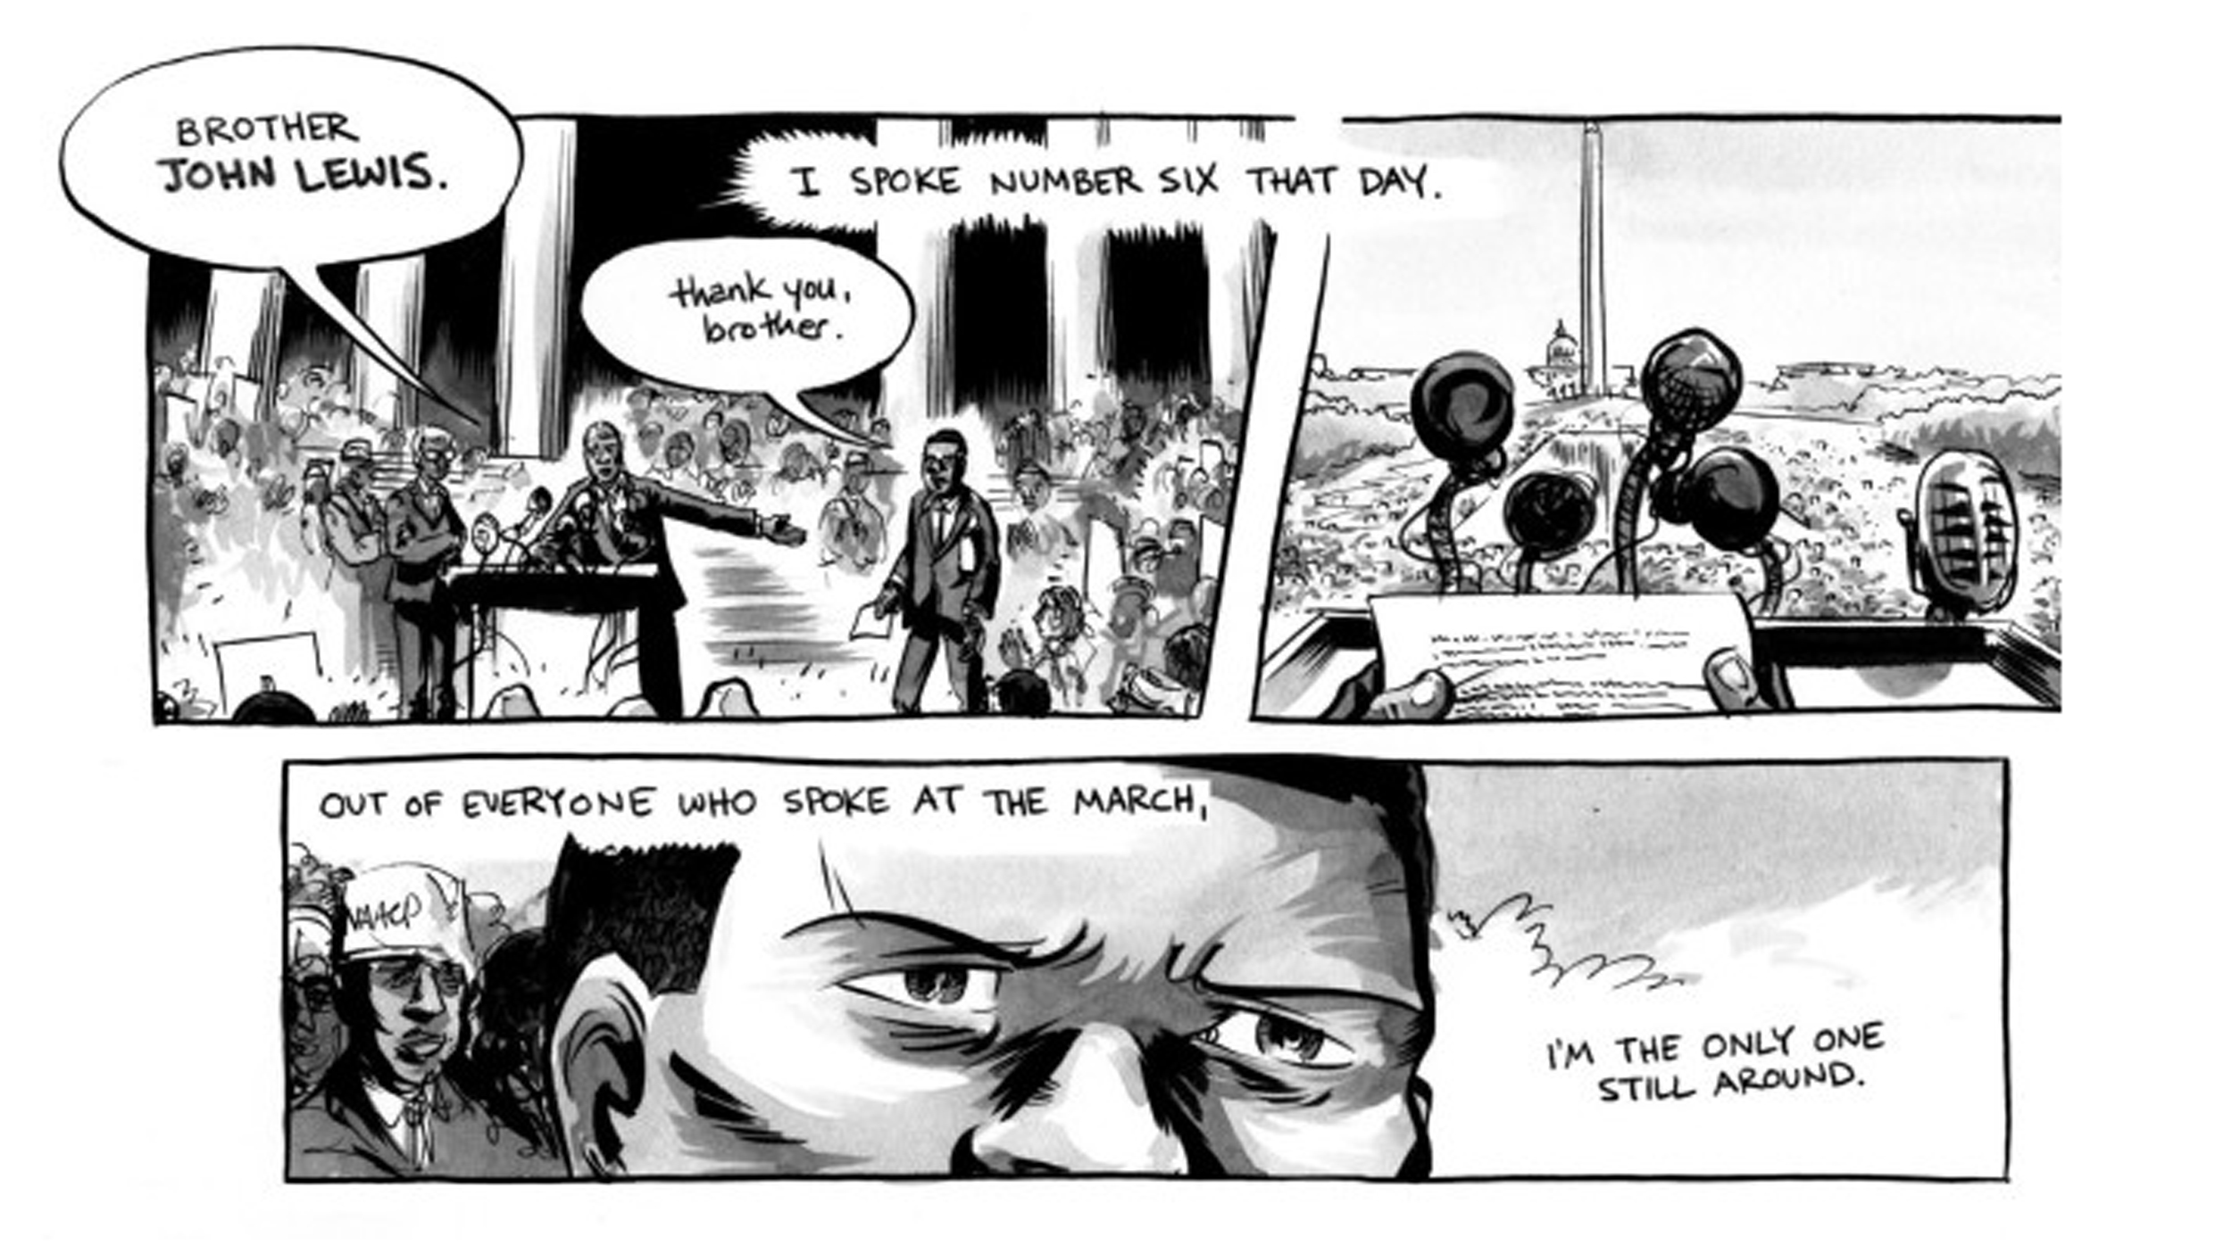
Graphic Weight

Slide 7
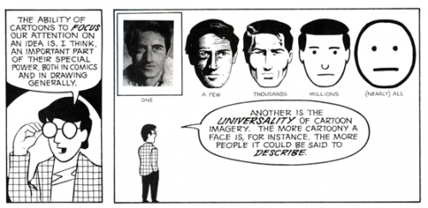
Abstraction

Slide 8
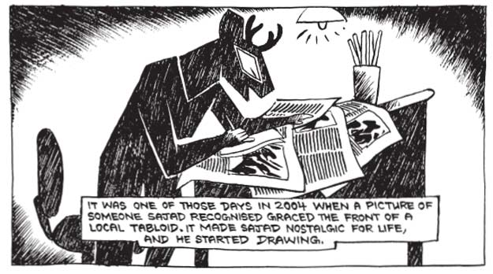
TEXT - captions

Slide 9
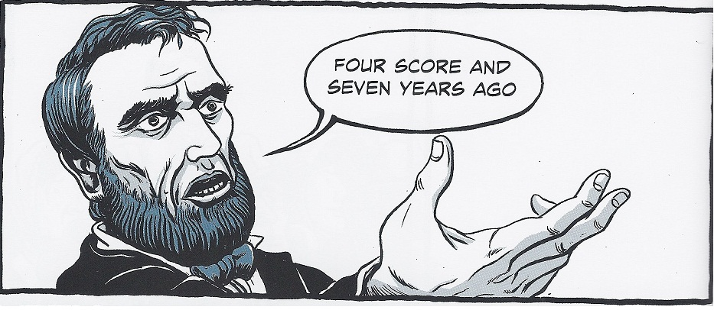
TEXT – External dialogue

Slide 10
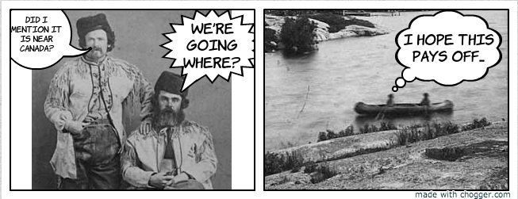
TEXT – internal dialogue

