Slide 1
“Who were the Populists and the Progressives…
and what became of them and their causes?”

Slide 2
Study Questions
What factors and events contributed to the Populist Movement?
Who were the Populists & what was their Platform?
What conditions contributed to the end of Populism?
What is the Legacy of the Populist Movement?

Slide 3
Text assignment—Zinn 175-180
1. What is Socialism?
2. What is Communism?
3. What is Anarchism?
3. What is Capitalism
4. What was the purpose of the Sherman Anti-trust Act?
5. What is the significance of the Haymarket affair?

Slide 4
Anarchism:
Full Definition of ANARCHISM
: a political theory holding all forms of governmental authority to be unnecessary and undesirable and advocating a society based on voluntary cooperation and free association of individuals and groups

Slide 5
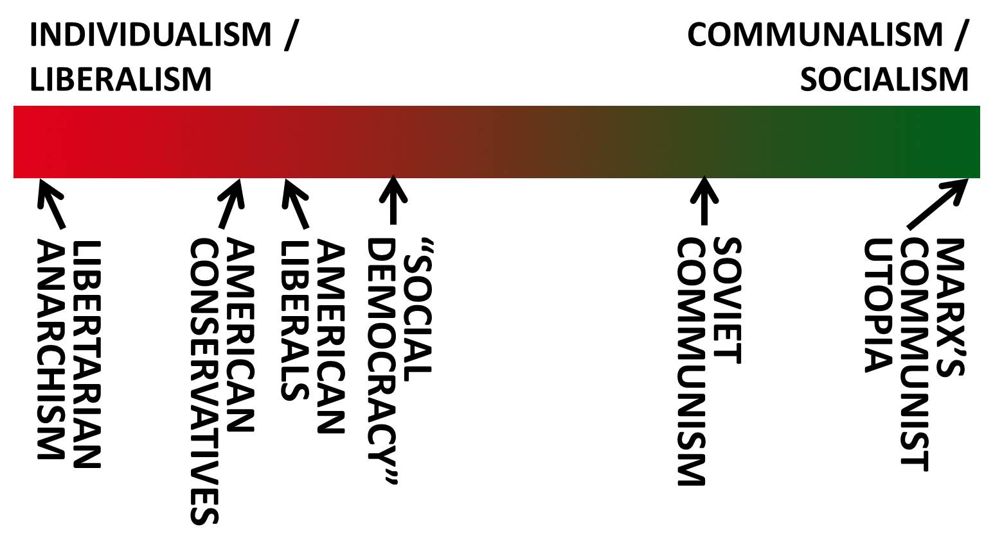

Slide 6
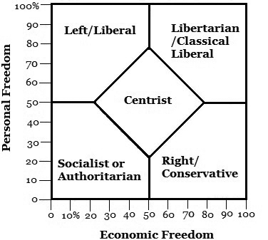

Slide 7
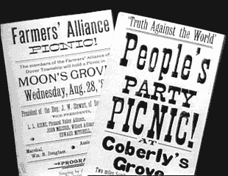

Slide 8
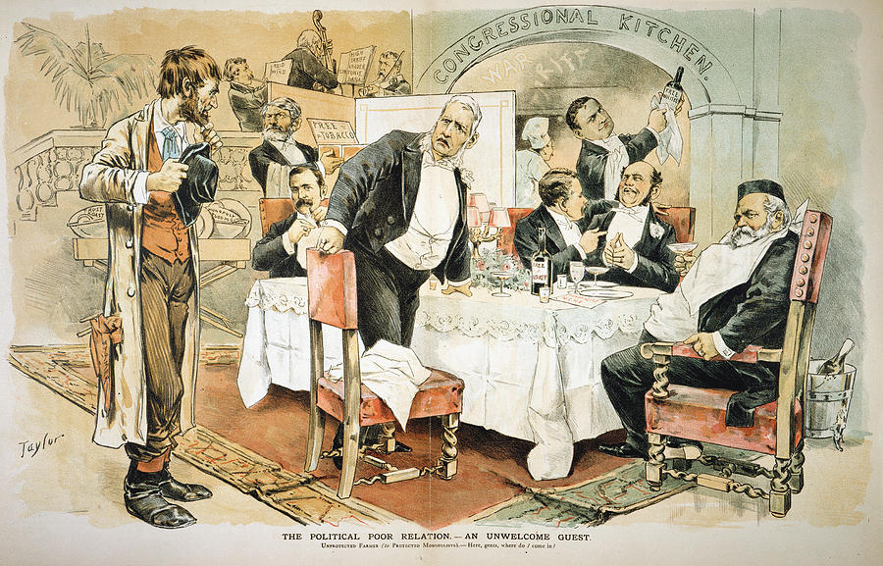

Slide 9
Populists, Progressives, and their Impact on the Modern United States—Overview:
I. Agrarian Discontent
II. The Omaha Convention, 1892
III. The Election of 1896
IV. Origins of Progressivism
V. Elements of Progressivism
VI. Long-term Impact

Slide 10
Who were they?
Farmers, Ranchers
Live in Midwest, South & West
People who did not share in the wealth created by industrialism
What does a Farmer do?

Slide 11
I. Agrarian Discontent
A. Economic Crises
technology, foreigners, RRs…DEBT
B. Price Parity
-Rail Road, Grain Elevators, Farm Implements.
C. Bad weather
D. Political Responses
1. The Granges
2. The Alliances
3. Kansas Populists, 1890
Mary E. Lease

Slide 12
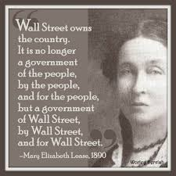
Lease holds a solid place in America’s radical history. She was affectionately dubbed the “People’s Joan of Arc,” the “female Old Hickory,” “Our Queen Mary,” The Kansas Tornado,”or simply the “heroine” by agrarian, labor, and women’s rights supporters during the late-nineteenth century.

Slide 13
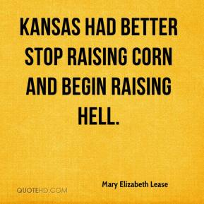
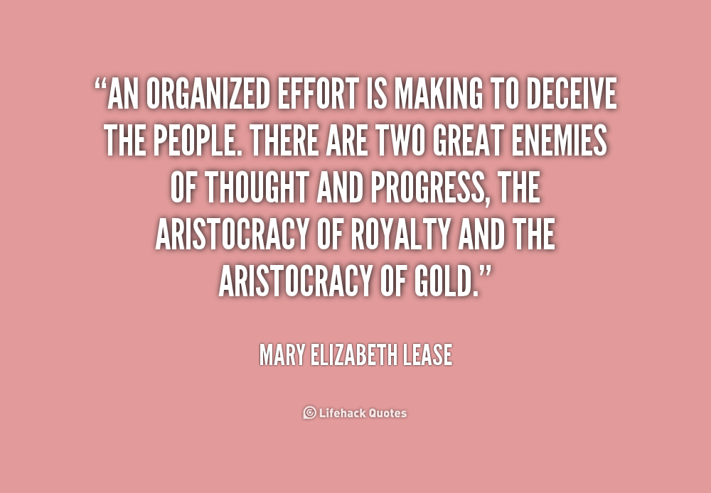

Slide 14
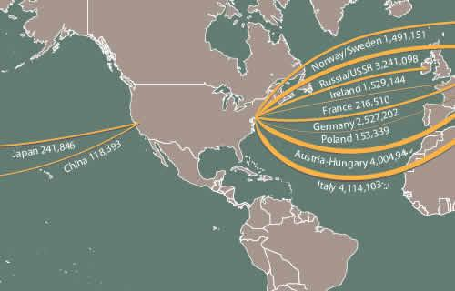
The Populists did not like Immigrants….Humm

Slide 15
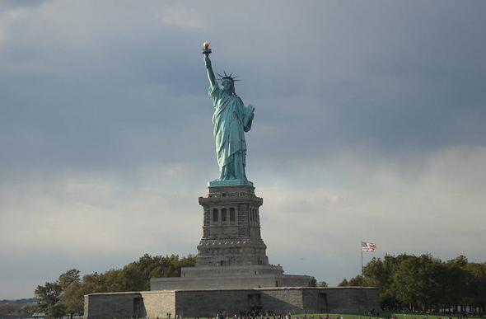
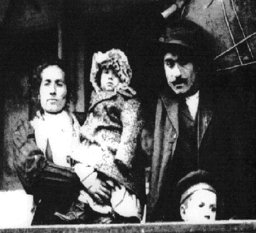
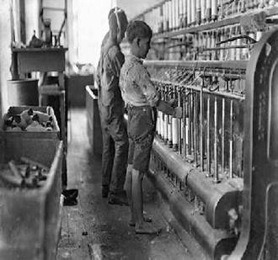
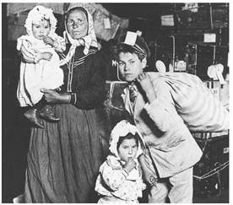

Slide 16
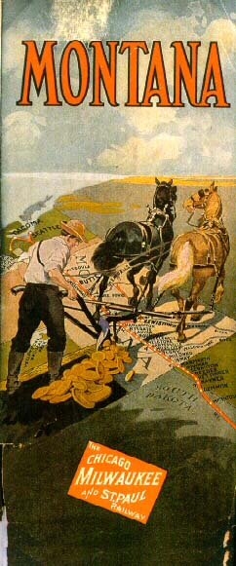

Slide 17
II. The Omaha Convention, 1892
Their Platform—What they wanted:
1. Direct election of senators
2. Primary reforms
3. Referendum/initiative/recall
4. Secret ballot
5. Nationalization: RR/utilities
6. Immigration restriction
7. 8-hour day
8. “FREE SILVER”-Bimetalism
9. Presidential candidate:

Slide 18
Platform:
1. Direct election of senators
2. Primary reforms

Slide 19
Platform
3. Referendum/initiative/recall
4. Secret ballot

Slide 20
Platform
5. Nationalization: RR/utilities
6. Immigration restriction

Slide 21
Platform
7. 8-hour day
8. “FREE SILVER”-Bimetalism

Slide 23
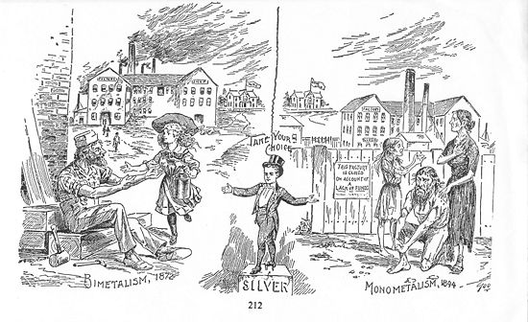
FREE SILVER?
Bimetalism
Monometalism

Slide 24
Platform
9. Presidential candidate:

Slide 25
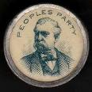
JAMES B. WEAVER--POPULIST

Slide 26
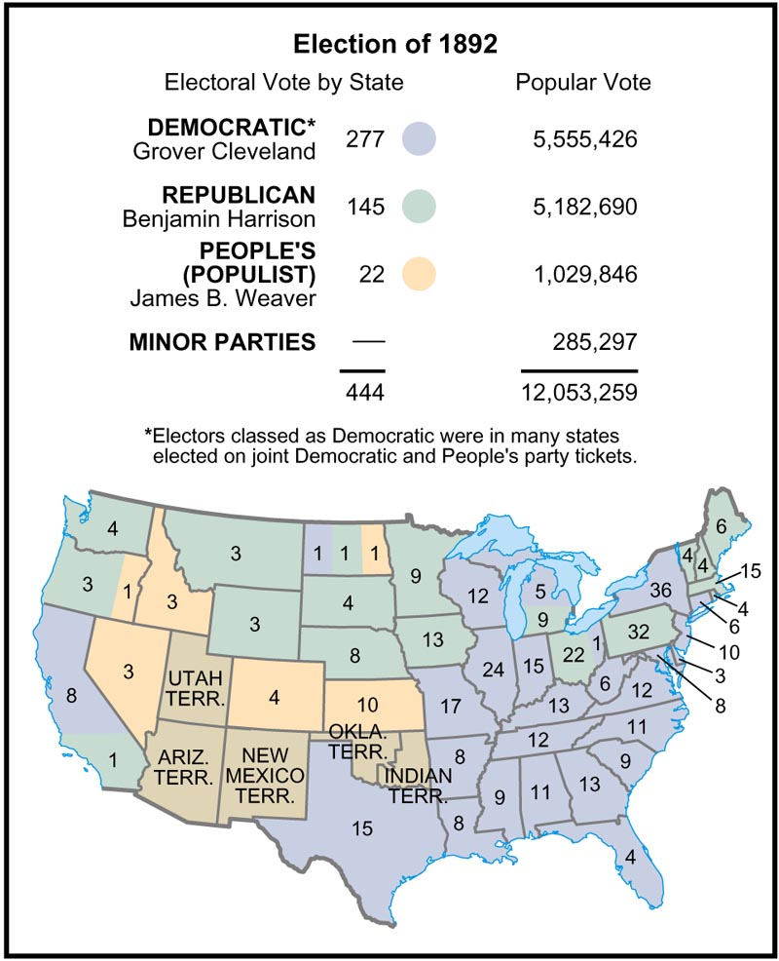

Slide 27
III. The Election of 1896
A. Republican: William McKinley
B. Democrat/Populist: William J. Bryan
D. The Vote
E. A Populist Tale

Slide 28
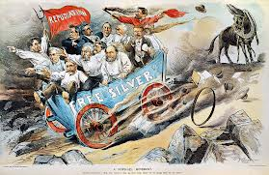
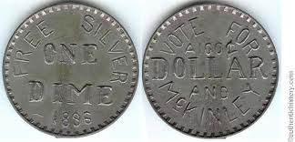
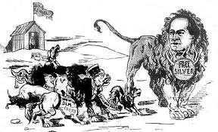

Slide 29
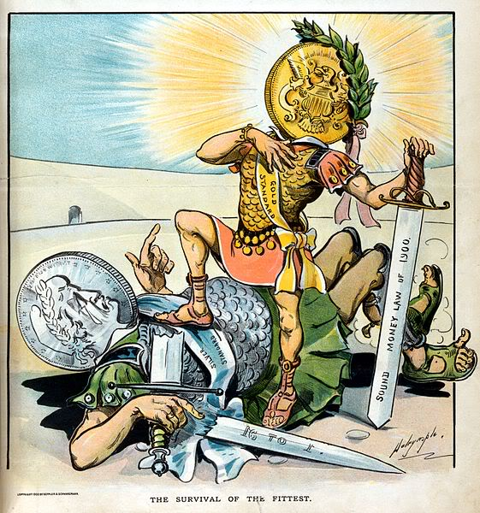

Slide 30
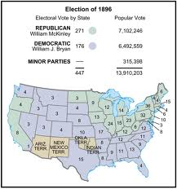

Slide 31
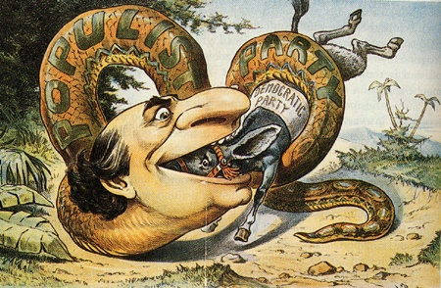

Slide 32
Why Did Bryan Lose?
Eastern Media, Industrialists and Bankers are afraid of Bryan:
Media conspires to defeat Bryan
Potential Political Reforms
Potential Economic Reforms
Overall Perception by the elite that the Democratic Party had become too radical.
Limited urban support.

Slide 33
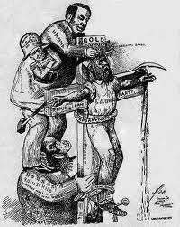

Slide 34
IV. The End of Populism
Gold discoveries
Alaska & South America
Improvement in weather
Better harvests
Spanish-American War
distraction
Not inclusive Enough-only Rural
Rural vs. Urban

Slide 35
V. Legacy/ impact
3rd Party Movement
? Can a 3rd party win?
Paved the way for the Progressives (Platform of 1892)
Illustrates the flexibility of the American system

Slide 36
Quiz tomorrow
Open Notes.

Slide 37
WIZARD OF OZ CHARACTER CHART
http://www.usagold.com/gildedopinion/oz.html
Create a character chart for “The Wizard of OZ” which describes the meaning of at least eight characters/things from the wizard

Slide 38
Progressivism!
??-Identify and describe the four goals of Progressivism.
P 306

Slide 39
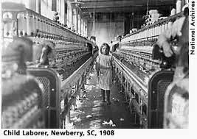

Slide 40
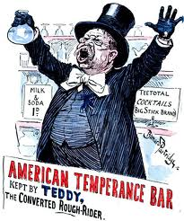

Slide 41
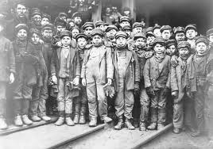

Slide 42
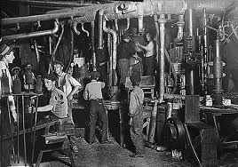

Slide 43
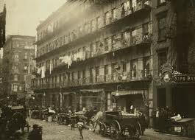

Slide 44
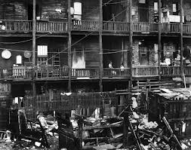

Slide 45
Summary—25 words p.306-----
1. protecting social welfare
2. Promoting moral improvement
3. creating economic reform
4. fostering efficiency
5. reforming local governments.
6. reforming mayors
7. reforming governors
8. protecting working children
9. effort to limit working hours

Slide 46
10. reforming elections
11. photojournalism (311)
12. direct election of senators
13. Lincoln Steffens (326)
14. Ida Tarbell
15. Upton Sinclair

Slide 47
IV. Origins of Progressivism
A. Populism Redone
*”A Progressive is simply a Populist who shaved his whiskers!”
B. Socialists
C. Muckrakers p. 326-327
Identify the significance of:
1. Lincoln Steffens
2. Ida Tarbell
3. Upton Sinclair

Slide 48
Origins Continued..
Teddy Roosevelt
Trust buster
Father of conservationism

Slide 49
Roosevelt--Conservation
Forestry Service
Gifford Pinchot is the first chief of this new agency.
Lands reserved for Public use and extraction
huge irrigation projects
Forest reserves in the U.S. went from approximately 43-million acres to about 194-million acres!

Slide 50
Roosevelt-Conservation
Established five national park units:
Proclaimed a total of 18 national monuments:.

Slide 51
Roosevelt-Trust Buster
Saw himself as representative of all the people, including farmers, laborers, white collar workers, and businessmen.
*He sought to regulate, rather than dissolve, most trusts.
Aggressively used the Sherman Antitrust Act .

Slide 52
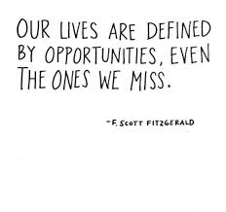

Slide 53
TR reform legislation
Rail Roads
Pure Food and Drug
Conservation
Labor Relations
Corporations-Wall Street
Banks

Slide 54
TR-the dark side
Race
Strong believer in Anglo-Saxon superiority
Did seek advice from members of other races…..
Booker T Washington

Slide 56
Evolution of Prohibition
Identify:
Temperance
Prohibition
WCTU-Francis Willard, Carrie Nation.
Functions and dysfunctions of Saloons.

Slide 57
Prohibition…
Identify and describe the reasons and justifications for Temperance and Prohibition.
Why did early efforts toward Prohibition fail (pre 1860)?
Identify and describe the successes and failures of the WCTU and the Anti-Saloon League.

Slide 58
What factors/groups/events ultimately led to the passage of the 18th Amendment?
The answer:
Health and families
WCTU & ANTI-SALOON LEAGUE
16TH AMENDMENT
Widespread support:
Rich and Poor, Liberal and Conservative, religious and free

Slide 59
What factors/groups/events ultimately led to the passage of the 18th Amendment?
WW I
PROPAGANDA!

Slide 60
Three Paragraph essay
Identify and describe five factors/groups/events which ultimately led to the passage of the 18th Amendment?

Slide 61
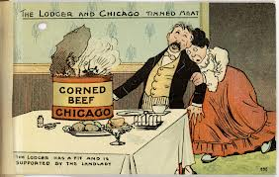

Slide 62
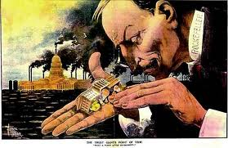

Slide 63
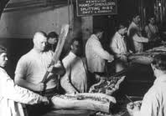

Slide 64
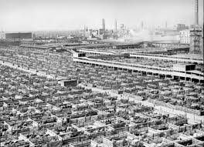

Slide 65
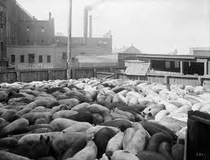

Slide 66
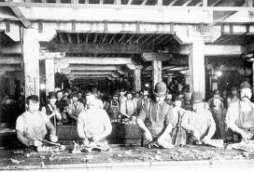

Slide 67
V. Overview: Elements of Progressivism
A. Democracy
1. Direct Primary
2. Initiative, Referendum, and Recall
3. Direct Election of Senators
B. Efficiency/Professionalization
1. In Business
2. In Government
C. Regulation
D. Social Justice
1. Child Labor
2. Working Hours
3. Prohibition
4. Women’s Rights

Slide 68
DEMOCRACY!!
A. Democracy
1. Direct Primary
2. Initiative, Referendum, and Recall
3. Direct Election of Senators

Slide 69
EFFICIENCY and PROFESSIONALIZATION
B. Efficiency/Professionalization
1. In Business
2. In Government

Slide 70
REGULATION
C. Regulation

Slide 71
SOCIAL JUSTICE!
D. Social Justice
1. Child Labor
2. Working Hours
3. Prohibition
4. Women’s Rights

Slide 72
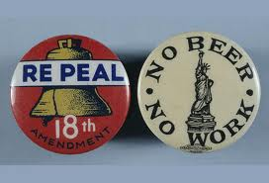

Slide 73
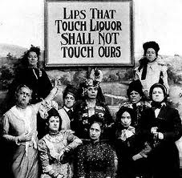

Slide 74
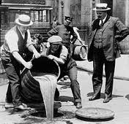
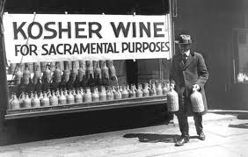
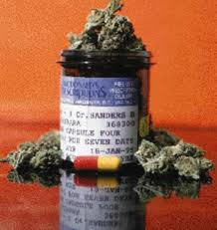
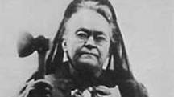

Slide 75
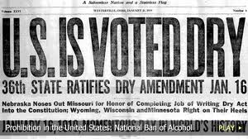

Slide 76
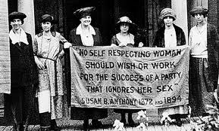

Slide 77
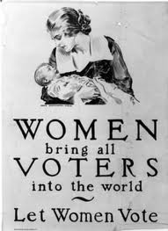

Slide 78
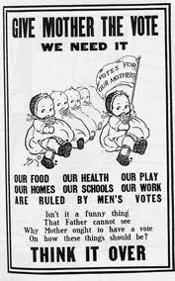

Slide 79
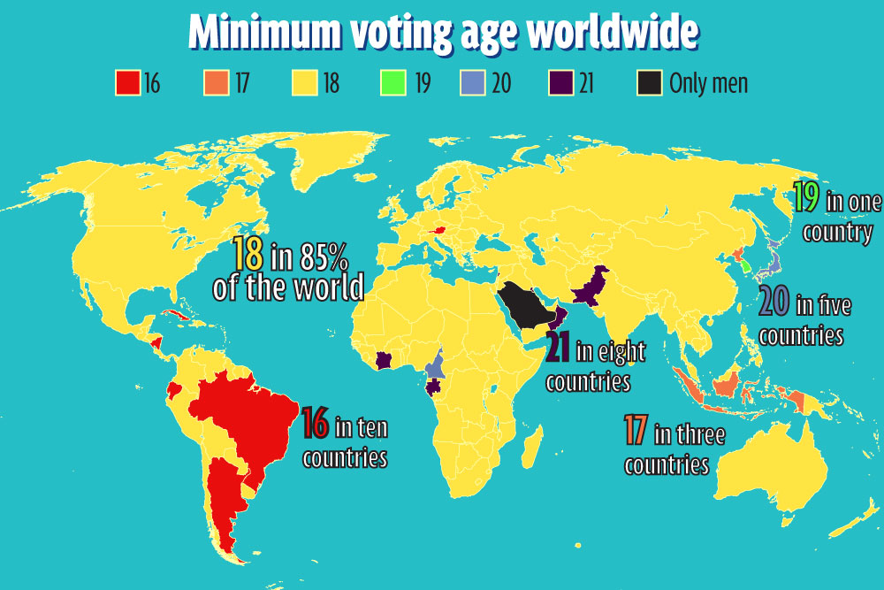

Slide 80
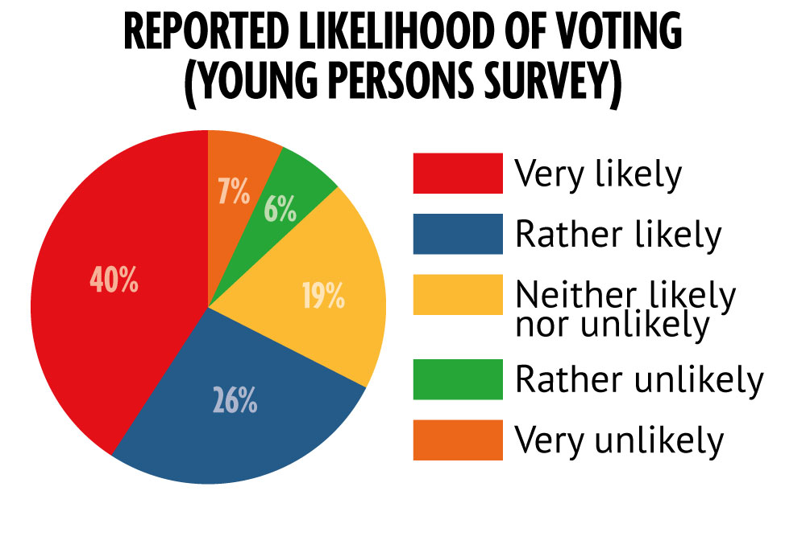

Slide 81
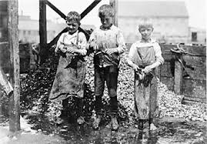

Slide 82
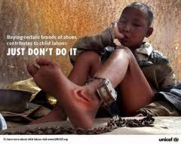

Slide 85
VI. Long-term Impact
*Increased the middle class☺
*Improved electoral democracy☺
*women’s rights/suffrage☺
*Prohibition. ☹
*labor reform☺
*Poor record on race☹
*immigration reform: Red Scare☹

Slide 86
VI. Long-term Impact..
In many respects, the progressive movement temporarily saved American Capitalism/Democracy!
Significant reforms, however will not occur until “The New Deal” 1933-1940

Slide 87
Progressivism & “the Dawn of Mass Culture” Activity
1. turn to page 292
2. you will work on your own.
3. read and create a poem or rap over the section you are assigned.
4. The poem or rap should represent the most important aspects of your section.
5. The poem or rap should be 12 lines.
6. complete assignment in your notebook.
7. In 20 minutes each student will present!!....GO!!

Slide 88
Ashley: Amusement Parks. 293
Nicole: Bicycling 293
Trace: Tennis 293
Mr. B: Spectator Sports 294
Alec: Baseball 294
Steven: Mass Circulation Newspapers. 294
Jason: Promoting the Fine Arts. 295
Taylor: Popular Fiction. 296
Wyatt C: Vaudeville Theater & The Circus. 298
Lindsey: The silver screen & Ragtime music. 299
Chantel: Urban Shoping, Department Store & The chain store. 296
Shantel: Advertizing, Catalogs and RFD. 297
Dean: One American’s Story. 292
Wyatt L: Data File. 299
Sean: Also, Mass Circulation Newspapers. 294
Tanner: Also, Advertizing & Now & Then. 297

Slide 89
GO!!!!!
The clock is ticking!!

Slide 90
Wonderful Wednesday!
1. Current Event/finish poem-rap!
2. present poem/ rap
3. Allegory Presentations
3. Progressive notes
4. Video

Slide 91
Open notes quiz
1. What is Socialism?
2. Why are the following important to the Progressive Movement?
a. Lincoln Steffens
b. Ida Tarbell
c. Upton Sinclair
d. Teddy Roosevelt
3. Identify the 4 elements of the Progressive Movement.
4. List the legacies of the Populist Movement.

Slide 93
Period 1 quiz
What is the difference: Populism vs. Progressivism
What is a muckraker
Identify 3 muckrakers and why they are famous
What is socialism
Identify the four elements of Progressivism
Why is Teddy Roosevelt significant
When you finish open notes quiz:
1. read ch. 10. section 1. do questions2 & 4 on page 345.

