Slide 1
Discussion Questions
“Stockings”
“Church”
“The Man I Killed”

Slide 2
“Stockings”
What is the purpose of telling the story about Dobbins and the panty hose?
Do you believe in good luck charms?

Slide 3
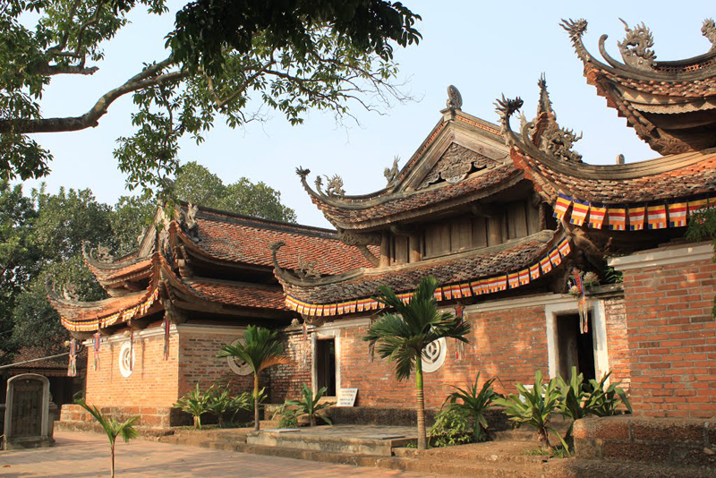
“Church”
Explain Kiowa’s response to camping at a Pagoda. How would you feel?
Explain Henry Dobbins’ relationship with religion. Why do you suppose the monks take a liking to him?

Slide 4
“The Man I Killed”
What is the effect of O’Brien describing the dead Vietnamese soldier over and over?
“The Man I Killed” describes fairly intimate aspects of the dead man’s life. Briefly outline them. Where do these details come from? How can O’Brien know them?

Slide 5
Theme Prompt
After reading ___________________, write an organized essay in which you identify and explain the significance of two of the story’s central themes. Support your interpretation with evidence from the text. Your analysis should be approximately four paragraphs, including an introduction and conclusion. Each body paragraph should have at least 3 concrete details with analysis (1 body paragraph for each theme). Focus on how the theme develops through the ENTIRE story.

