Slide 1
Indicate if you agree or disagree with the statements below. WHY?
Judicial, executive and legislative power are the primary functions of Government.
“Majority rule” ensures the proper balance between individual rights and the social good.
The Declaration of Independence is much more radical than the constitution.

Slide 2
Work with a buddy
Law enforcement and Judges are part of different branches of government.
The constitution made slavery illegal and provided women with the right to vote.
We have A LOT more people today than when the Constitution was written so we clearly need a new constitution.
“…it’s a free country” or is it?

Slide 3
What you need to know…
the strengths and weaknesses of the Articles of Confederation.
Identify the “values” or strengths of the Articles
Identify and explain the major elements of the Constitution.
Identify the Legacies of the Constitution
Compare and contrast the Constitution with the Declaration of Independence.

Slide 4
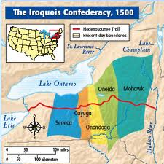
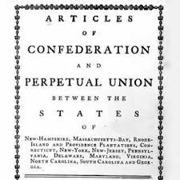
The Articles of Confederation and the Constitution—Practice makes Perfect?

Slide 5
What is The Articles of Confederation?
The Articles of Confederation is the original constitution of the US, ratified in 1781, which was replaced by the US Constitution in 1789.
In this context, the Confederation was a loose union of the 13 Colonies for common interest.
In The Articles States were very strong and the National Government was very weak.
Why?

Slide 6
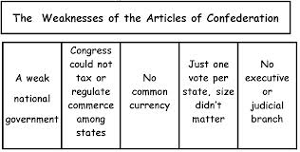
These problems are explicitly illustrated by…………

Slide 7
Shays rebellion—1787 ☹
"This dreadful situation has alarmed every man of principle and property in New England. [People wake] as from a dream and ask what has been the cause of our delusion. What [will] give us security against the violence of lawless men? Our government must be [strengthened], changed, or altered to secure our lives and property." (Henry Knox Letter to George Washington)

Slide 8
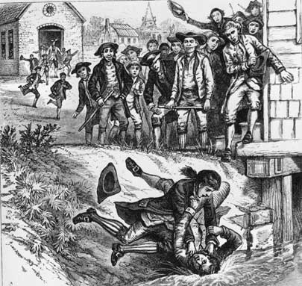
A creditor/banker is attacked amid the wild cheers of a mob of farmers

Slide 9
Shays Rebellion or.. “Return of the Regulators?!!”
Large numbers of farmers and small property owners were unable to pay their debts and taxes.
Why?
The post revolution economy was In recession.
To fund State government, States like Massachusetts heavily taxed farmers and land owners.
These taxes disproportionally hurt farmers which typically lived in the Western part of the state.
Creditors tended to live in the Eastern part of the State (Boston).
This led to many foreclosures.

Slide 10
Shays Rebellion or.. “return of the Regulators?!!”..continued:
Creditors also demanded “hard currency”
No Universally accepted paper currency!
Farmers appeal to the Mass. legislature but are denied relief.
Violence ensues under the direction of enraged farmer, Daniel Shay.
Regulator like mob rule sweeps over Western Mass.
Revolt is highlighted by an assault on the State Arsenal (Springfield) in January 1787.

Slide 11
Shays Rebellion--continued
The State asks for help from the Federal Government yet the federal government is too weak to help.
The State eventually puts the rebellion down.
Many mob leaders go on trial yet are pardoned.
This rebellion illustrates the weakness of the articles and the need for a stronger Federal Government! Thus the Constitution!

Slide 12
Value of the Articles ☺
Bought time for America:
Gave America time to adjust to a unified form of self rule—
Adjust to a Representative Democracy
Addressed Financial problems
Improved credit rating
Established foreign trading relationships.

Slide 13
Value…continued ☺
Northwest Ordinances (see page 72):
Land Ordinance of 1785
Split territory in specific “units” to encourage settlement!
Established rights of Territories
Northwest Ordinance of 1787
Governance and admission to the Union

Slide 14
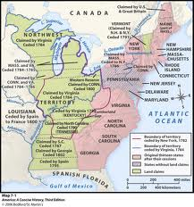
NORTHWEST ORDINANCES: THE BIG PICTURE

Slide 15
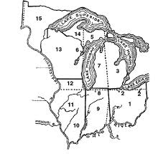
NW ORDINANCES—THE MEDIUM PICTURE

Slide 16
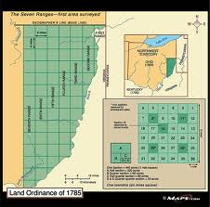
NW ORDINANCES—THE SMALL PICTURE

Slide 17
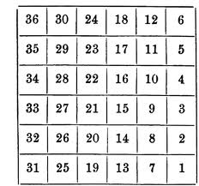
NW ORDINANCES—THE MICRO PICTURE!

Slide 18
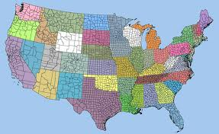
NW ORDINANCES HELPED SHAPE TODAYS AMERICA!

Slide 19
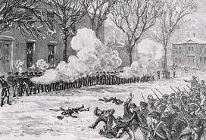
The Massachusetts State Militia Puts Down Shays assault on the Arsenal in Springfield—The Federal Government under the Articles, was incapable of helping!

Slide 20
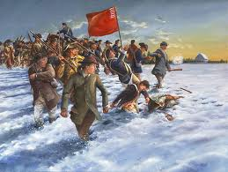
Shay’s Rebellion: living up to America’s Legacy of Regulator Action.

Slide 21
Constitutional Convention. A meeting of Elites
1787—Philidelphia
How old were they?
Where were they from?
What was their educational background?
What were their occupations?
http://teachingamericanhistory.org/convention/the-delegates/

Slide 22
ELEMENTS OF THE CONSTITUTION
Popular Sovereignty
Federalism
Delegated, concurrent, reserved
Separation of Powers

Slide 24
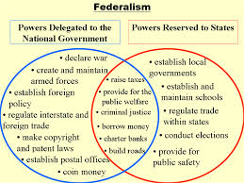

Slide 25
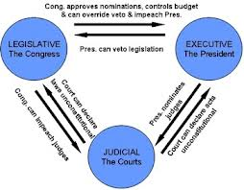

Slide 26
ELEMENTS
Checks and Balances
3 independent branches of Government
Why is this important?
Checks on the Power of the People
Electoral College & Indirect Election of U.S. Senators.
Why did the Founding Brothers distrust the Common Man?
Amending The Constitution
By State vote & Congress
Why is it hard to amend the Constitution?

Slide 27
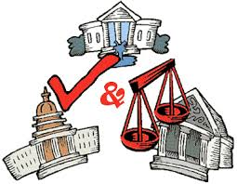

Slide 28
Compromise…..
The Great Compromise
Virginia Plan + New Jersey Plan
2 houses; = representation and proportional population!
North-South Compromise
Three-fifths compromise
For determining proportional representation!

Slide 29
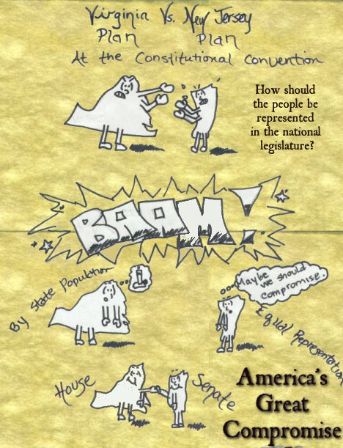

Slide 30
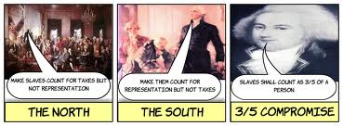

Slide 31
Compromise
The Bill of Rights!
Federalists vs. Antifederalists
Guarantee of the rights of Individuals and States!
What is your Favorite? Why?

Slide 32
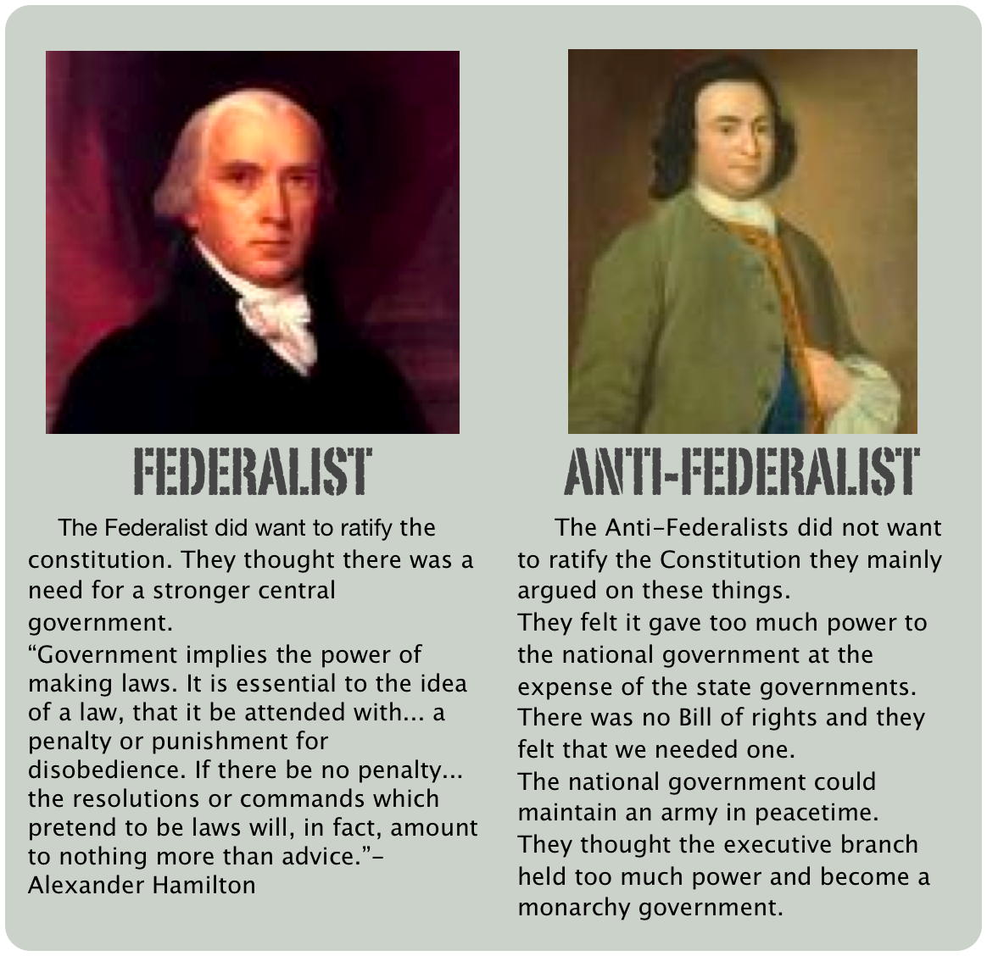

Slide 33
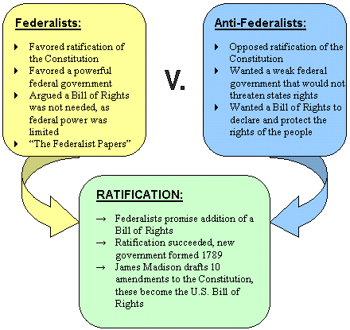

Slide 34
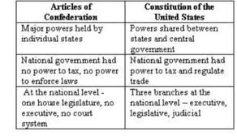
Lets compare….A of C vs. the Constitution☺

Slide 36
Evaluation of the Constitution
Elite
Examples?
Most educated, wealthy & influential people of colonial society

Slide 37
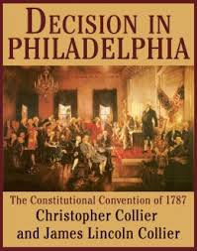
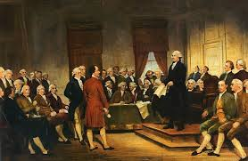
The American Constitution; a meeting of elite men

Slide 38
Evaluation….
Compromise
Examples?
The Great Compromise, The 3/5 Compromise, The Bill of Rights.

Slide 40
Evaluation
Flexible
Examples?
The Constitution is a “living Document” which has adapted over time…….

Slide 42
Proof is in the Pudding, or Proof is in the Whiskey?
http://americanhistory.abc-clio.com/Search/Display/252812?terms=whiskey+rebellion

Slide 43
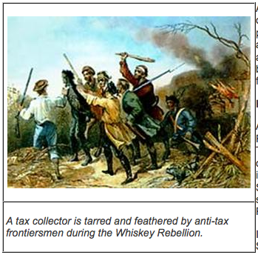

Slide 44
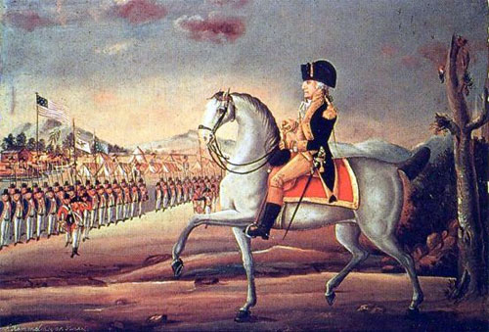
Concerned at the threat to the republic posed by the angry protestors, President George Washington invoked martial law. He ordered 12,000 troops to confront the rebels, and rode out with a large force from Harrisburg. The march marks one of only two occasions in U.S. history that a sitting president personally commanded an army. The Rebellion was crushed illustrating the functional power of the new government.

Slide 45
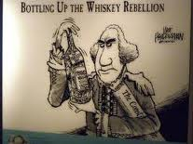

Slide 46
Create an Amendment
Work with a buddy
Write an Amendment
How will it change our country, government, law etc…………….
Display your work on poster paper—make it beautiful.

